Slide 1
TAP LIGHT UP WORKSHOP
Project Created By: Jared Alt, Sterling Abrams, and Anh Thu Nguyen

Slide 2
About TAP
TAP otherwise known as the Technology Ambassador Program is an award winning program at GGC which aims to
Increase interest in programming the the number of students who commit to an IT major.
Provide outreach opportunities for GGC students through developing games and programs and presenting them to introductory STEM courses
Develop soft skills

Slide 3
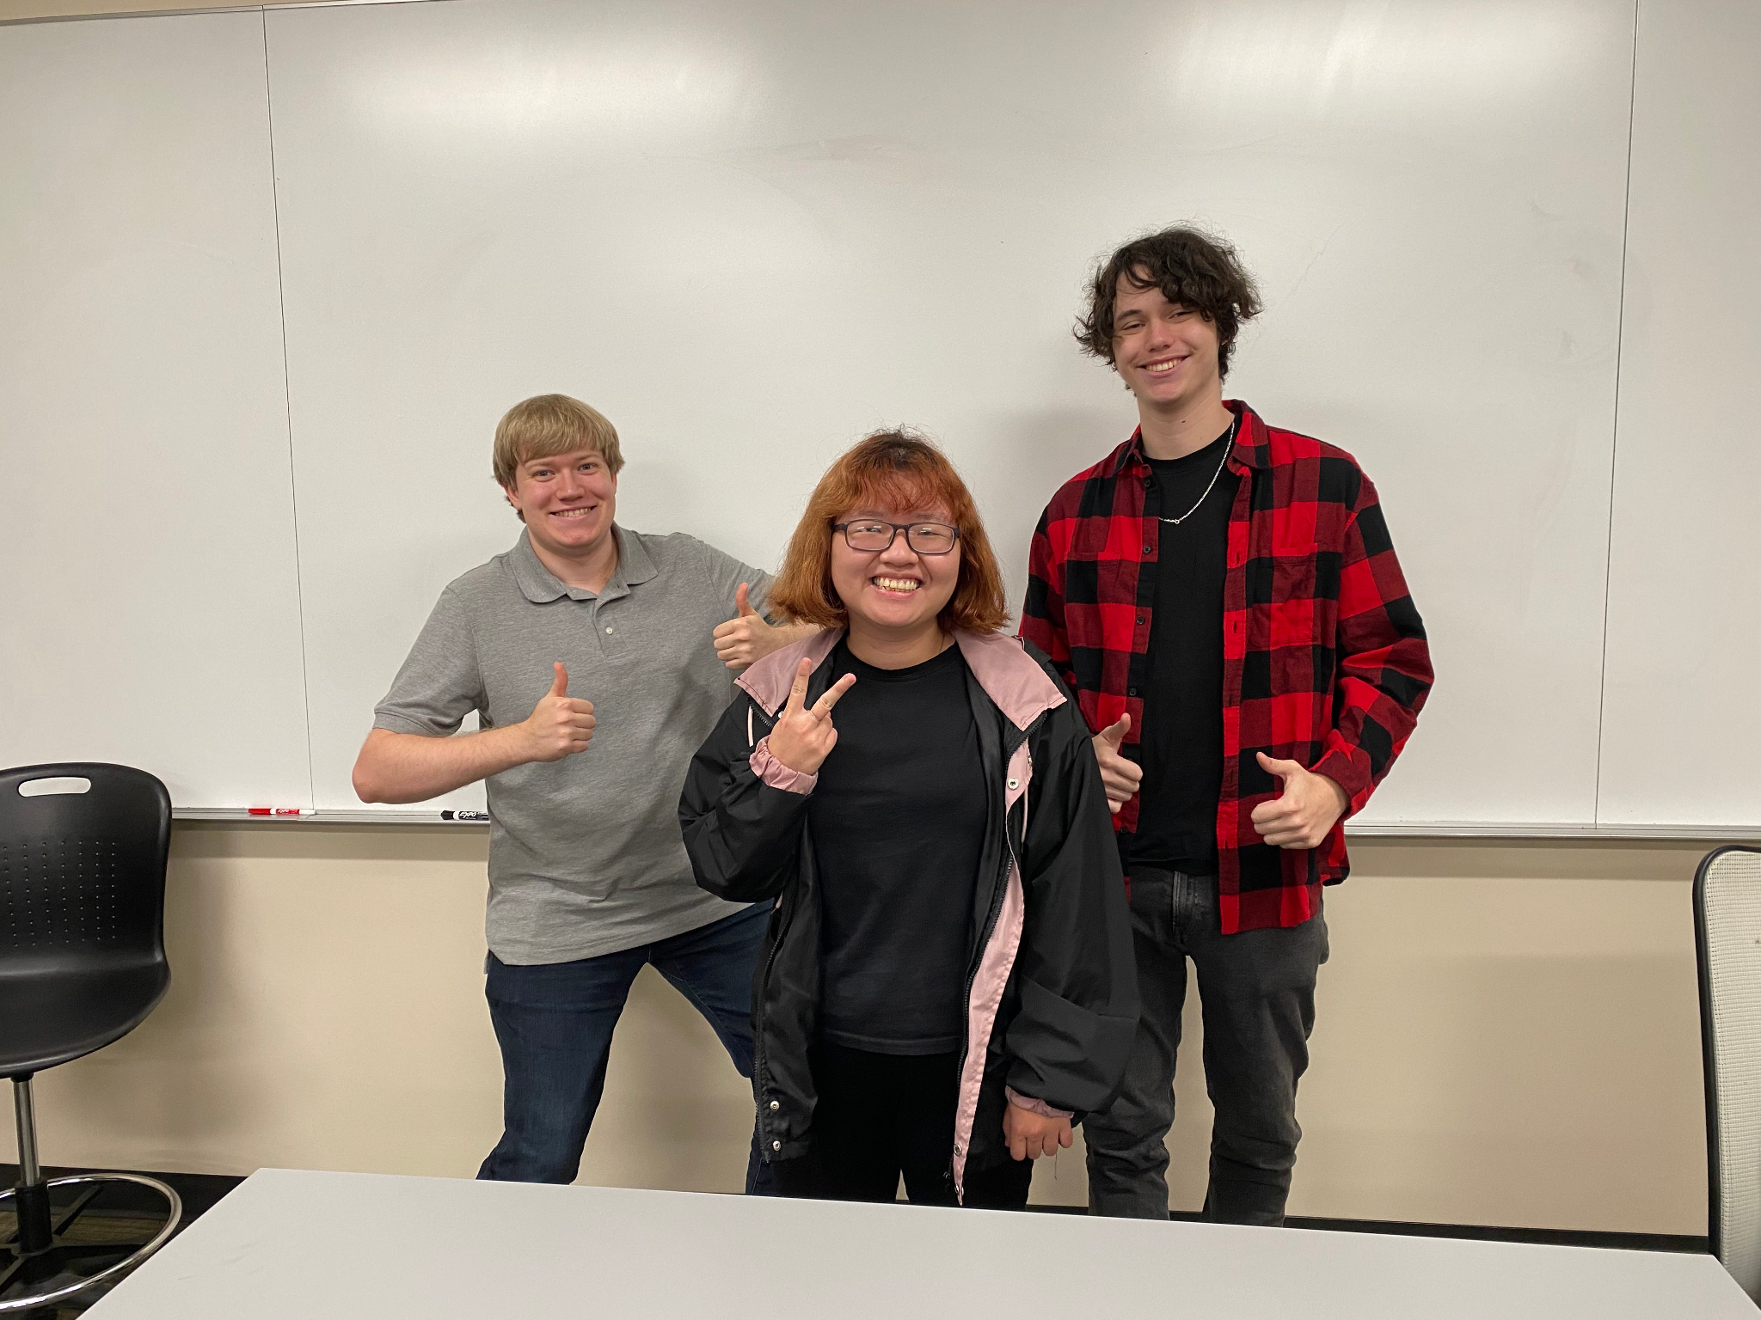
The Creators!
From left to right
Sterling Abrams, Anh Thu Nguyen, Jared Alt

Slide 4
Meet The Creators (Cont)
Jared:
Software Development student
No formal coding experience until this project
Sterling:
Digital media student
Advanced Scratch programing experience
Anh Thu:
Software Development international student
Intermediate in Java, C++, Scratch, Tynker

Slide 5


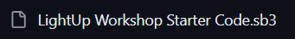

Download Starter File
Go to GitHub: TAP-GGC/LightUp-Teaching-Programming-Basics-with-Scratch (github.com)
Open the Documents -> LightUp Starter Files folders
Download the “LightUp Workshop Starter Code” by clicking the download button at the top right

Slide 6




Download Starter File – Part 2
Go to Scratch: https://scratch.mit.edu/
Click Create at the top of the page:
When your new page opens click “File” at the top of the page and select “Load from your computer”
Find where your .sb3 is and select “Open”

Slide 7
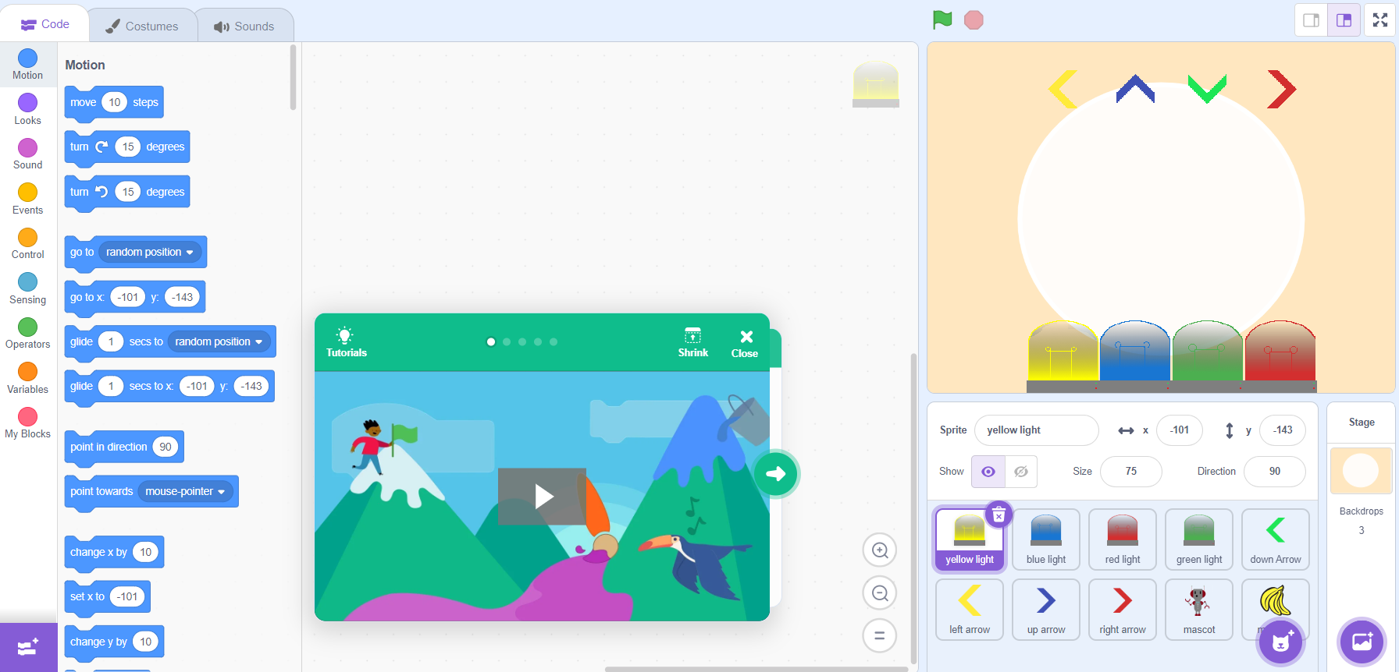
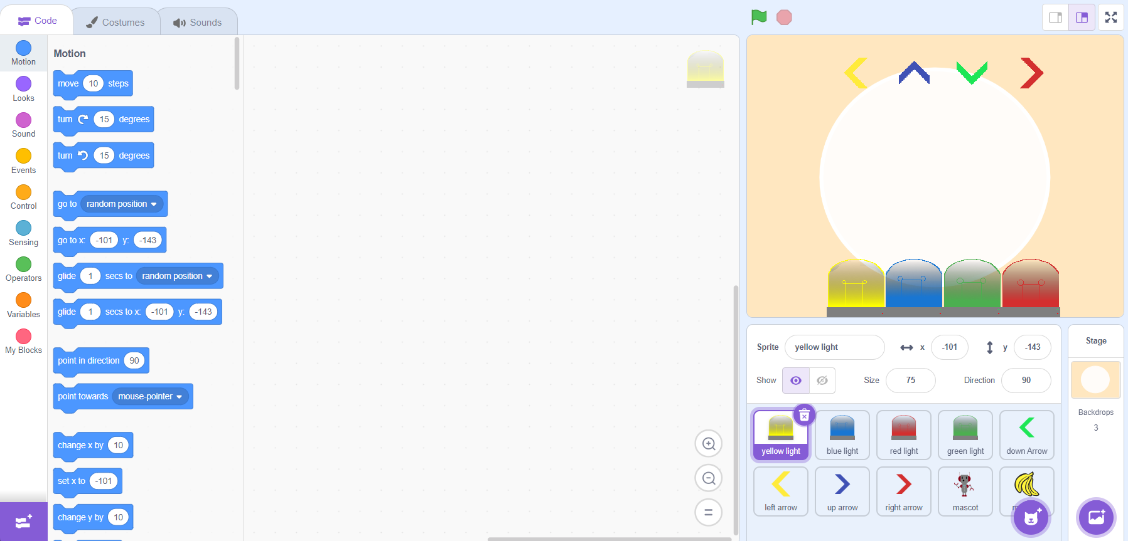
Download Starter File – Part 3
Let Scratch load your project and now your ready to start the workshop.
TIP: Close the green pop-up box that shows tutorials as you don’t need it

Slide 8
Download Starter File – Part 4
If the downloading process does not work you can click this link to be taken to the web version of the workshop: TAPS Light Up Starting file on Scratch (mit.edu)
Click the “See Inside” button

Slide 9
Introduction to Scratch

Slide 10
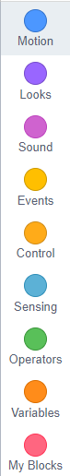
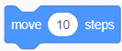
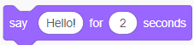
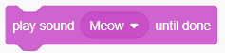
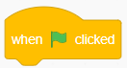
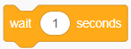
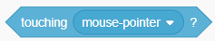

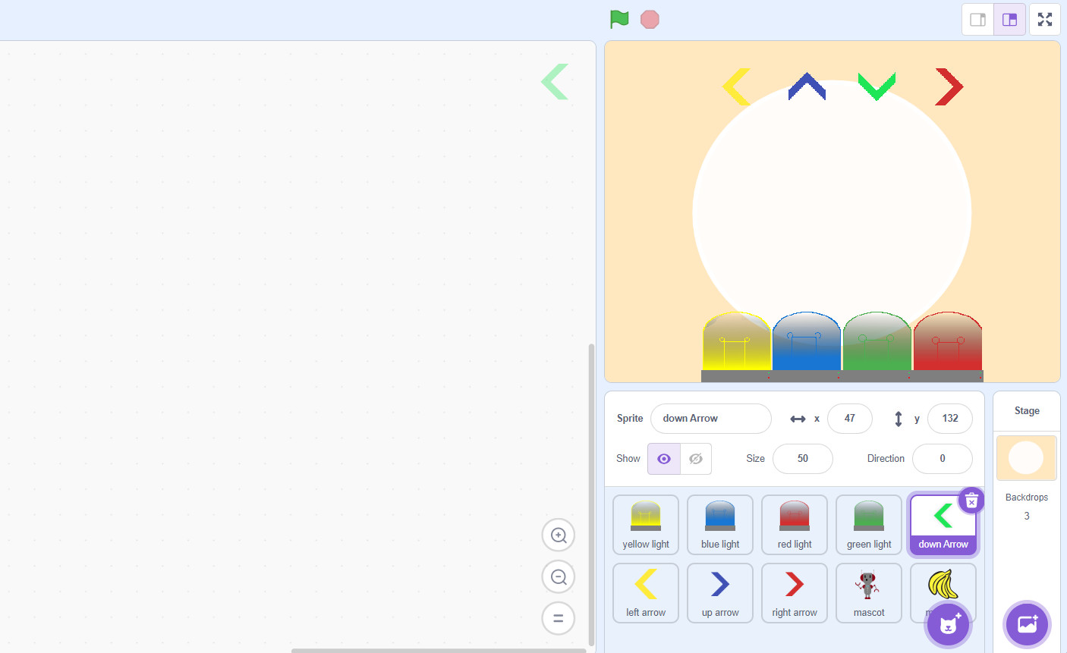

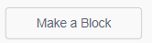
Get Familiar With Scratch
On the left, Scratch has organized the code blocks into different categories and each categorgy have their own coding blocks
The middle of your screen is the workspace and where we will place our code
On the right, is where the game will be displayed and where we will also be able to select the sprite we want

Slide 11
Get Familiar With Scratch – Part 2
Sprites is what Scratch calls an object or an image. They can be anything such as animals, shapes, or characters, but today we will be using lightbulbs and arrows.
They are going to be shown at the bottom right of our screen
You will know that you are working on a sprite if there is a purple box around the object

Slide 12
Get Familiar With Scratch – Part 3
At the top right of Scratch, you will see our “game-screen” this is where our sprites and the code will work together to make our game.
The green flag at the top is how we run our code, and the stop sign will stop any of our animations
Now let’s get coding!

Slide 13

Get Familiar With Scratch – Part 4
The most important thing is to make sur that you have the correct sprite selected at the bottom of your screen when coding
We will first start coding for the yellow lightbulb, so make sure you click the sprite at the bottom.

Slide 14
LightUp Workshop Part 1

Slide 15
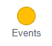
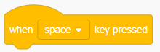
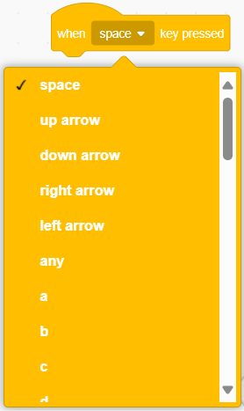
Turn on Lights
o To grab a beginning block, go the Events category
Find the “When ____ key pressed”, click and drag it to the workspace
o There is a drop-down menu for you to select what key triggers the code, select the “left arrow”

Slide 16
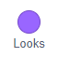
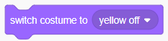
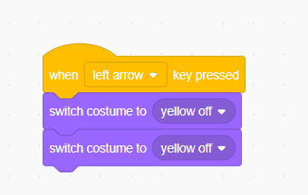
Turn on Lights – Part 2
o Go to the Looks category
Grab two of the “Switch costume to ______” block
o They should snap together with the starting block when they get close together

Slide 17
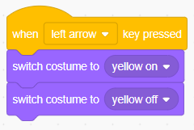
Turn on Lights – Part 3
o Change the first “Switch costume to _____” block to “yellow on”
Leave the second one alone
This will give our game the appearance that our game has flashing/blinking lights

Slide 18
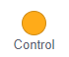
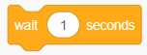
Turn on Lights – Part 4
Go to the Control category
Grab the “Wait ____ seconds” block
Sandwich it between your two “Switch costume to ______” blocks

Slide 19
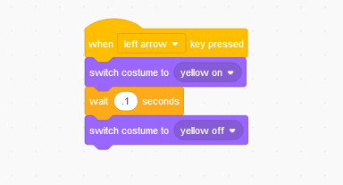
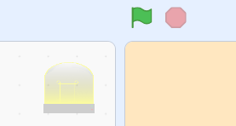
Turn on Lights – Part 5
You can use this block to adjust how long you want the light to stay on
The game uses .1 seconds
Now click the green flag and test it out

Slide 20
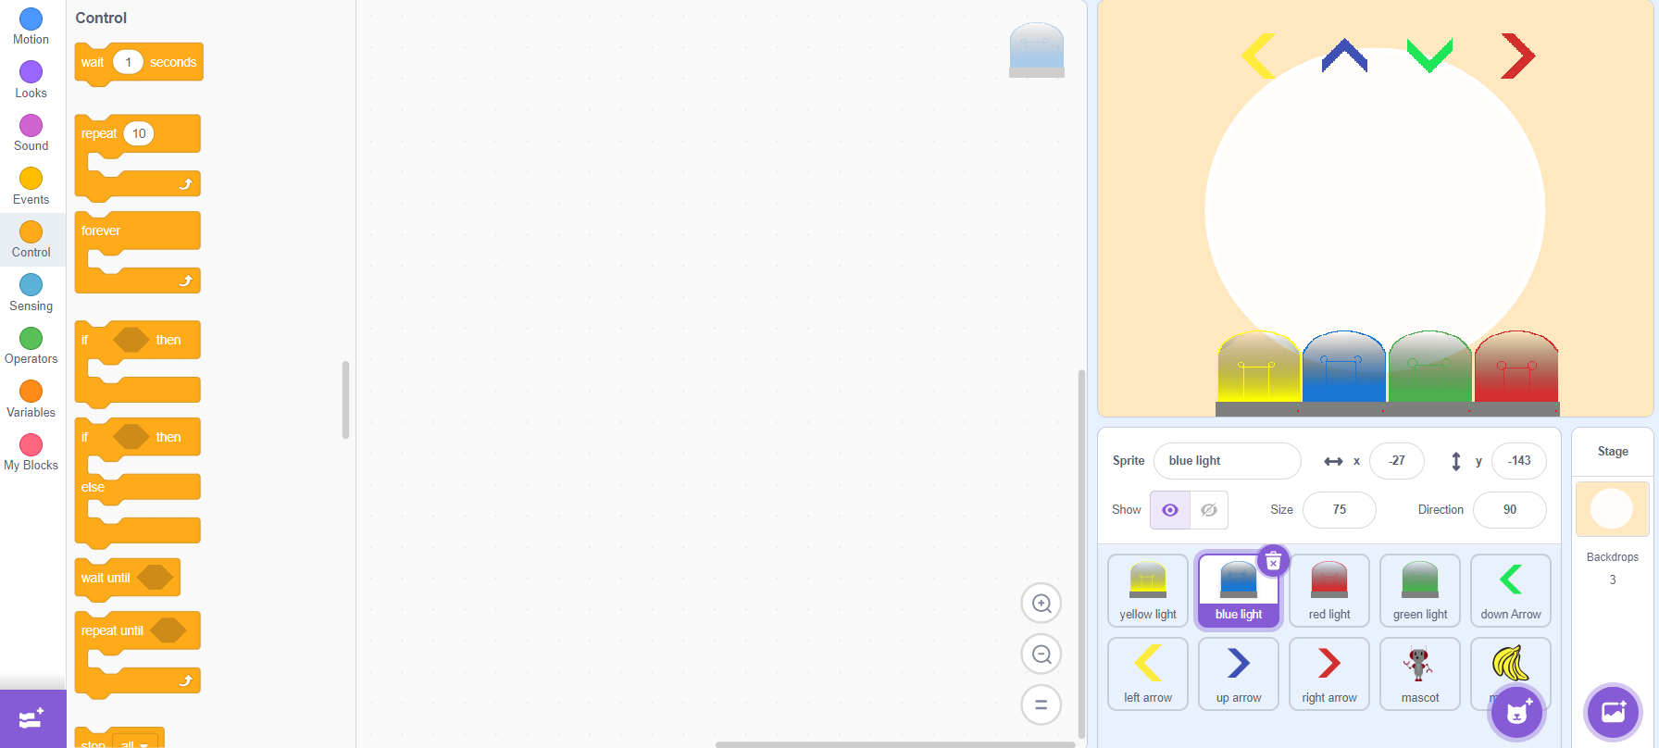
Your turn
If your code works, congratulations you have now made your first animation with Scratch
Follow the same steps to add the same animations for the rest of the lightbulbs
Make sure to select the sprite you want to work on

Slide 21
Your turn – Part 2
Use the “up-arrow” for blue lightbulb
Use the “down-arrow” for green lightbulb
Use the “right-arrow” for red lightbulb

Slide 22
LightUp Workshop Part 2

Slide 23
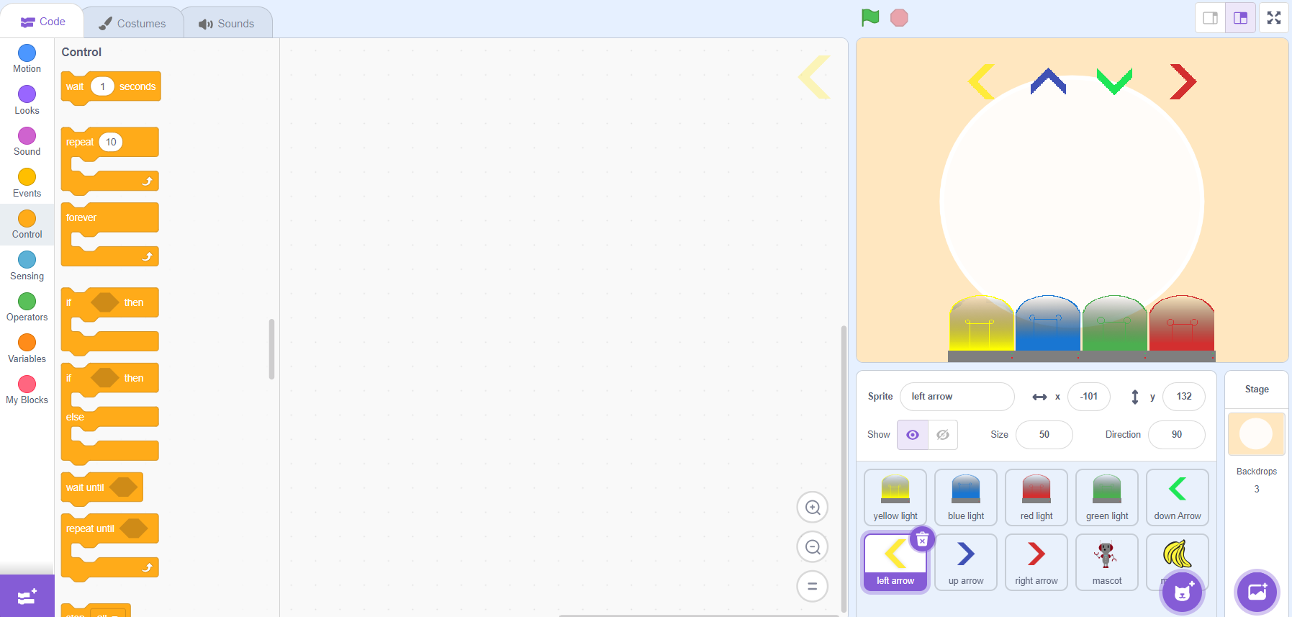
Falling Arrows
For this part of the workshop, we are going to create another animation for our game
We are going to have our game give the illusion that arrows are falling across the screen
So, we will focus on coding the movements for the arrows at the top of our page

Slide 24
Falling Arrows – Part 2
To start creating the falling arrows make sure to have the yellow arrow highlighted
We are going to focus on having the arrow fall straight down and stop when it hits yellow lightbulb

Slide 25
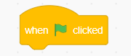
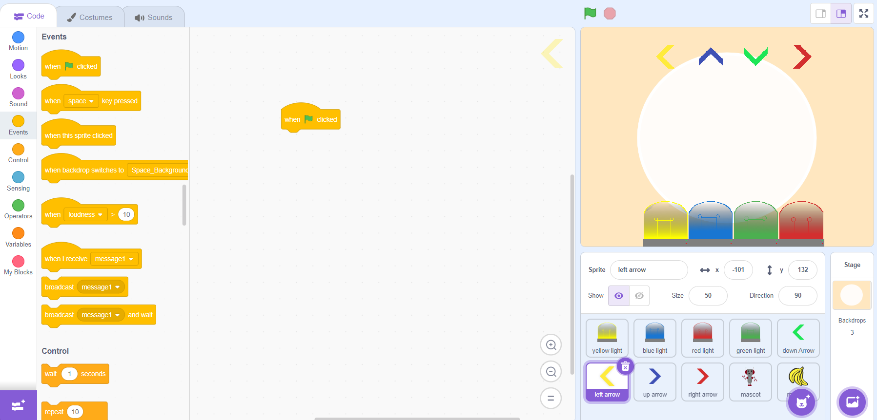
Falling Arrows – Part 3
o To grab a beginning block, go the Events category
Find the “When ___ clicked”, click and drag it to the workspace

Slide 26
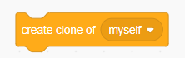
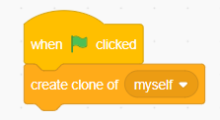
Falling Arrows – Part 4
o Go to the “Control” category and find the “Create clone of ______” block
Drag it to your workspace and place it under your “When ___ clicked” block so that they snap together

Slide 27
Falling Arrows – Part 5
What we just did was create a duplicate or clone of our sprite when the user clicks the green flag
Next, we are going to tell Scratch that when we create a clone of our arrow, we want to trigger a new start block with some action.

Slide 28
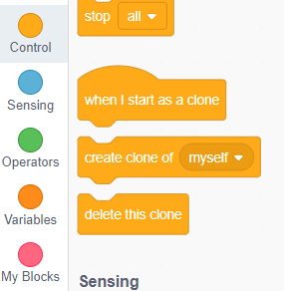
Falling Arrows – Part 6
To add the second part of our code we will need to move another “Control” block in our work area
Above our “Create clone of ______” block, there should be a “When I start as a clone” block above it
Take the block and drag it to your workspace

Slide 29
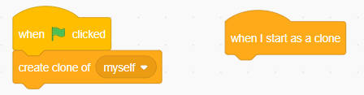
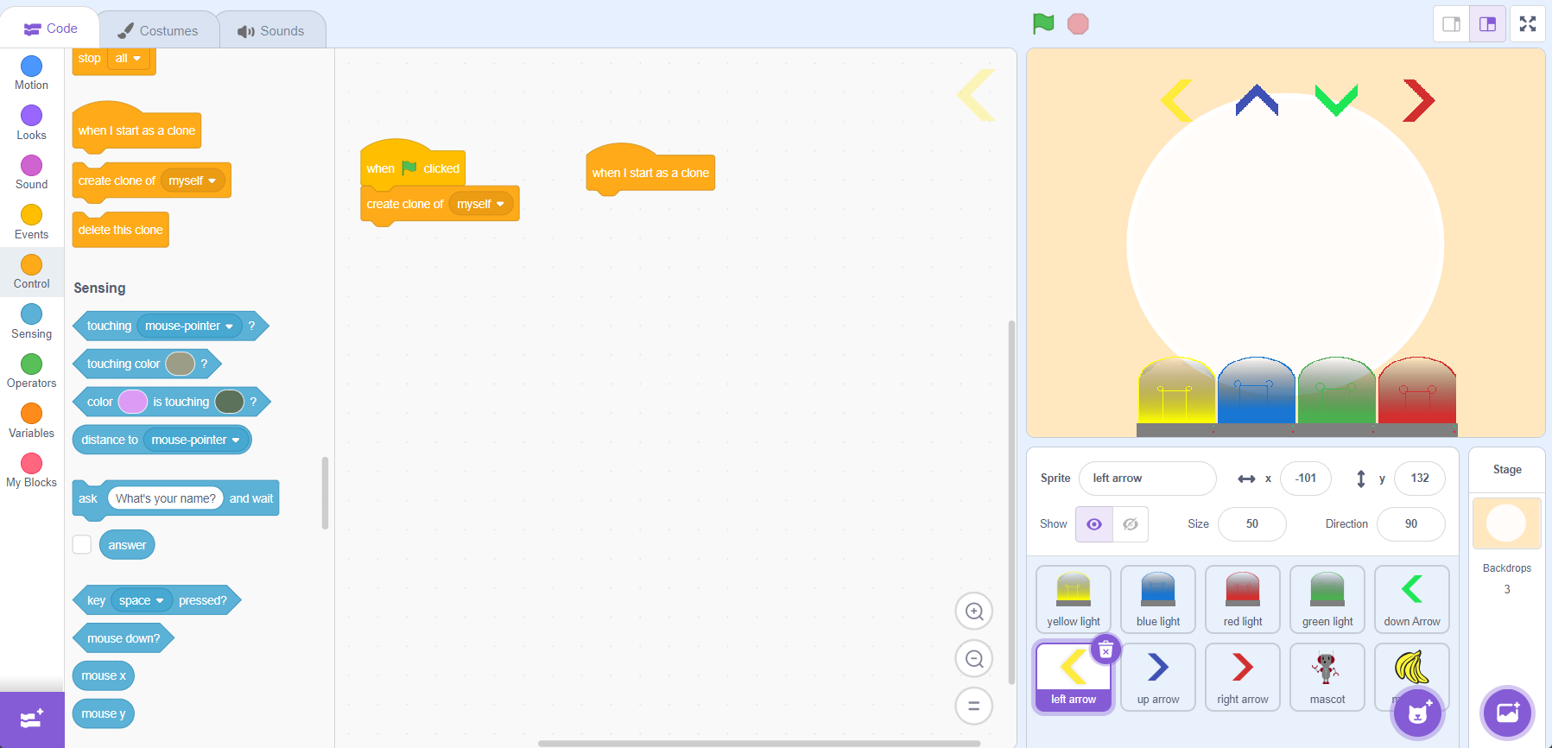
Falling Arrows – Part 7
Your workspace should now look like this with the blocks being next to each other
The “When I start as a clone” block and the code we are going to add underneath it is going to be triggered when a clone is created

Slide 30
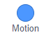
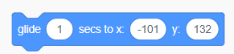
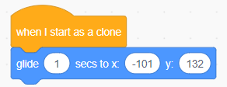
Falling Arrows – Part 8
o Go to the “Motion” category and find the “Glide __ secs to x: ___ y: ___” block
Drag it to your workspace and place it under your “When I start as a clone” block so that they snap together

Slide 31
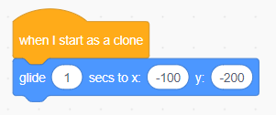
Falling Arrows – Part 9
o If your coordinates are different than the ones shown in the do not worry because we have to change them
For the X coordinates: -100
For the Y coordinates: -200

Slide 32
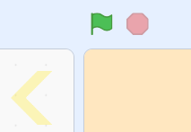
Falling Arrows – Part 10
o Click the green flag to see how your Scratch program works! If it works correctly a yellow arrow should fall and stop at the bottom of your yellow light.

Slide 33
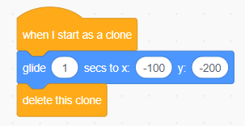
Falling Arrows – Part 11
o If it works, we now want to delete the clone after we are done with it, so all the clones don’t stack on top of each other
Go to the “Control” category and find the “Delete this clone” block.
Drag that block to your work area in the middle of your screen and place it under the “Glide ___ secs to x: ___ y: ___” block.

Slide 34
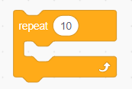
Falling Arrows – Part 12
Run the code again and now your arrow disappears after 1 second is up
To get the arrows to keep falling we need to use a loop. A loop repeats a set of code blocks over and over until our condition is over
Scroll to the top of the “Control” category and find the “Repeat ___” block. The entire block will be our loop and the number is our condition which tells our program how many times we want to repeat our code

Slide 35
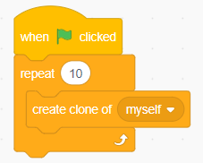
Falling Arrows – Part 13
Place this code under the “When ____ clicked” block and Scratch should put your “Create clone of _______” block in the “Repeat ___” block, but if it doesn’t drag the block inside
Run your code and see how all the arrows are clumped together?
We need to have our code wait before we create the next arrow.

Slide 36
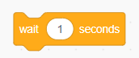
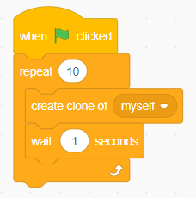
Falling Arrows – Part 14
In the “Control” category drag the “Wait ___ seconds” block under the “Create clone of _______” block. Then run your code again.
Now the yellow arrows now “fall” one by one.
If you feel like it’s still a little too fast, then adjust the seconds to your liking.

Slide 37
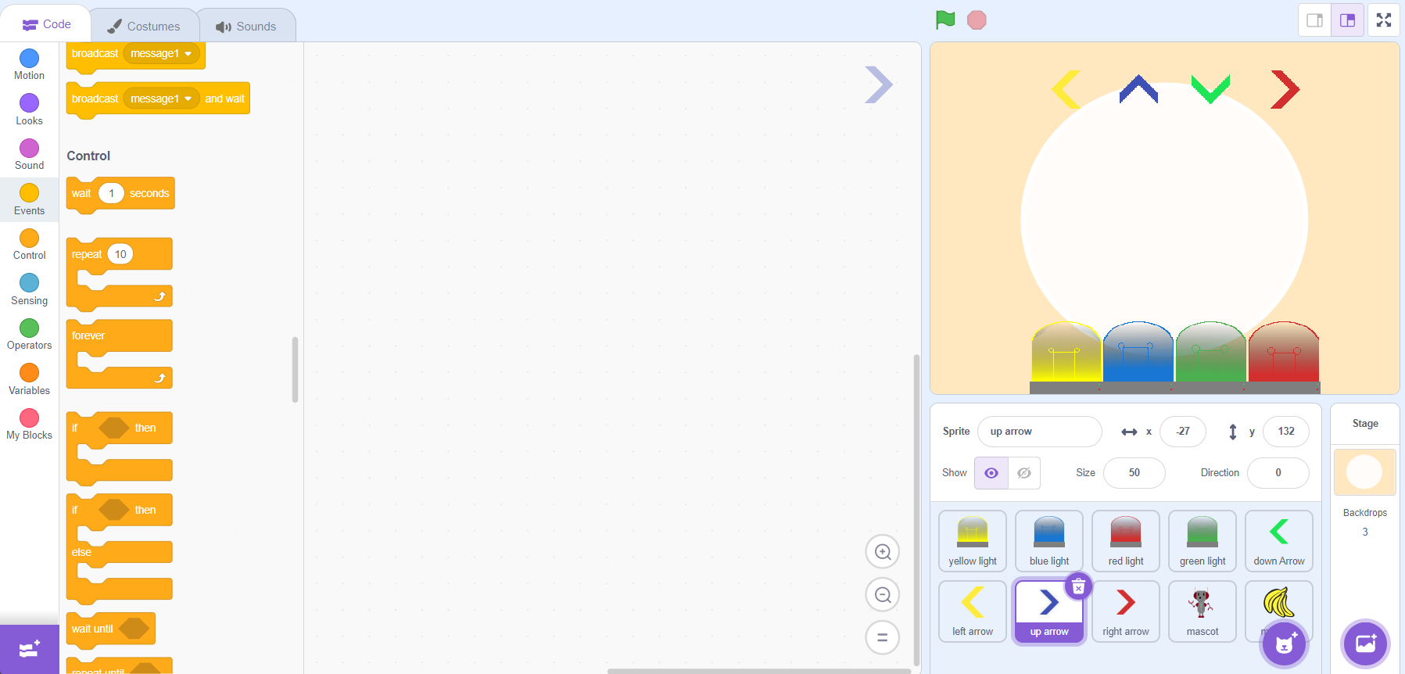
Your turn
If your code works, congratulations you have now made your second animation with Scratch
Follow the same steps to add the same animations for the rest of the arrows
Make sure to select the sprite you want to work on

Slide 38
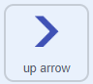
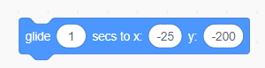
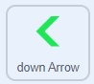
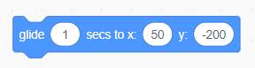
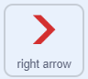
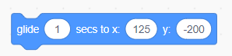
Your turn – Part 2
Use these coordinates for the rest of the arrows

Slide 39





Common Error: “My arrow is gone”
First step, check to see if the arrow is visible
This is found under the play space on the right-hand side
Second step, Scratch runs code blocks if you click on them, your arrow might have moved off screen, use these coordinates for the arrows to put them back

Slide 40
Time to add some hit registry
o On your arrows, grab the blocks:
o Events “when ___ is pressed”
o Control “if <___> then”
o Control “delete this clone”
o Sensing “touching ______ ?”
o Attach the delete clone inside the if sandwich
o Place the touching block in the if statement socket
o The touching block should be set to the matching color light

Slide 41

Checkpoint

Slide 42

Now to add Some Flair
o Under the Operators category, there is “pick random __ to __” you can slot this into the wait __ seconds in your arrow spawning loop. This will make the arrows spawn at random times so all the arrows don’t fall together every time
o Under Variables, click “Make a Variable” and name it score

Slide 43


Now to add Some Flair (Cont)
On the right side of the screen, near the sprites there is a section labeled “stage”
Select it, then drag out the
Events “when (green flag) clicked”
Variables: set score to 0
Select your arrows again, and drag out Variables: change score by 1
Slot it into the hit registry, inside the if statement, before the delete clone

